Slide 1
Dimensions & Tolerances
Aerospace Manufacturing Core Study Guide
“AMCSG-304”
Blueprints & Documents

Slide 2
Dimensions

Slide 3
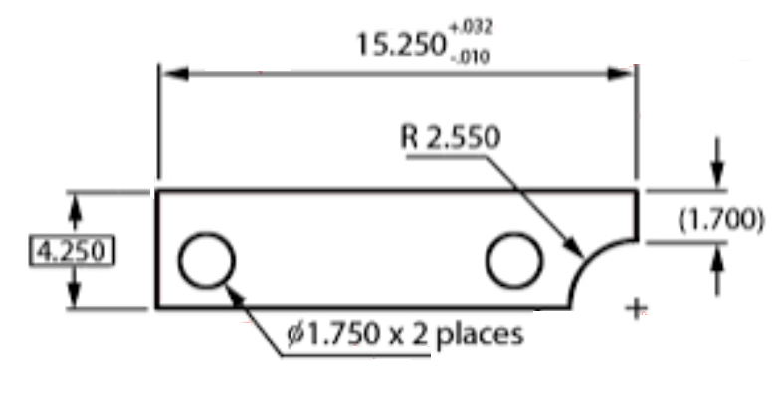
Dimensions: Overview
Dimension Line
Dimension
Tolerances
Arrowhead
Extension Line Beyond
Dimension Line
Extension Line
Visible Gap
(PD) U.S. Gov – NAVEDTRA14040A, 2015
Leader Line
Center Mark
Object
Dimension and Note
Notes:
ChatGPT query identified USGovernment public domain document: https://media.defense.gov/2017/Nov/03/2002658619/-1/-1/1/171103-N-ZY182-15347.pdf

Slide 4
Dimension Types: “Size” (1 of 3)
1. Size
2. Position
Linear
3. Angle
6.75”
Ø .50”
Diameter
R .45”
Radius
Matt Pierce, 2026
Notes:
Google: ”describe types of dimensions on a blueprint: size, position, and angle. show examples.”

Slide 5
Dimension Types: “Position” (2 of 3)
1. Size
2. Position
Hole Placement
3. Angle
.75”
.75”
Matt Pierce, 2026

Slide 6
Dimension Types: “Angle” (3 of 3)
1. Size
2. Position
3. Angle
Angle of Cutout
45°
Matt Pierce, 2026

Slide 7
“Chain” vs. “Baseline/Datum” Dimensioning
Chain Dimensioning
Baseline/Datum Dimensioning
Datum
50±.05
40±.05
30±.05
10±.05
20±.05
10±.05
10±.05
10±.05
Matt Pierce, 2026
Matt Pierce, 2026
Notes:
ChatGPT: in a single diagram, show the difference between "chain dimensioning" and "datum dimensioning"

Slide 8
Tolerances

Slide 9
Definition of Tolerances
“Tolerances are the allowable variations in a measurement” - Dr. Google
Example: 34” +/- 0.02”
= 34 inches
with a tolerance of plus or minus two-one-hundredths of an inch
34 +/-0.02
Matt Pierce, 2026

Slide 10
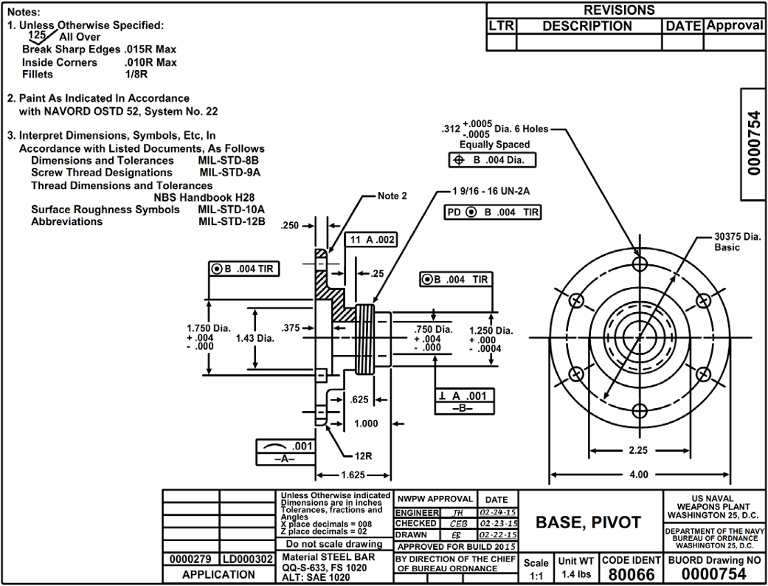
Location of Tolerances on Blueprint
In Separate Note
With Dimensions
For Critical Tolerances
In Title Block
(PD) U.S. Gov – NAVEDTRA14040A, 2015
Notes:
ChatGPT query identified USGovernment public domain document: https://media.defense.gov/2017/Nov/03/2002658619/-1/-1/1/171103-N-ZY182-15347.pdf (pg 69)

Slide 11
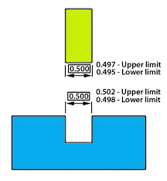
Types of Tolerances
Plus Minus Tolerances
Limit Dimensions
Unilateral
Bilateral
26.9
26.6
Maximum Tolerance
18
+0.03
0
18
+/-0.02
Minimum Tolerance
45°
0
-0.03
45° +/-0.02
Matt Pierce, 2026
Matt Pierce, 2026
Notes:
ChatGPT: use diagrams to show the different types of tolerances on aerospace blueprints. In particular, "plus and minus tolerances", "limit dimensions", "maximum tolerances" and "minimum tolerances"

Slide 12
Q&A

Slide 13
Practice Q&A’s (Q1-Q8)
Q5: What type of dimension shows the angle of one element relative to another?
A: Angle Dimensions
Q6: What type of dimensioning shows relative size, one piece to another in a single set of connected lines?
A: Chain Dimensioning
Q7: What type of dimensioning shows absolute size from a single reference point or surface for each piece?
A: Baseline Dimensioning (or Datum Dimensioning)
Q8: What are allowable variations in a measurement?
A: Tolerances
Q1: What are numeric distance measurements on a blueprint called?
A: Dimensions
Q2: What is the type of line connecting a note to a drawing object (e.g.: a to a hole)?
A: Leader Line
Q3: What type of dimension shows linear length, or diameter, or radius?
A: Size Dimensions
Q4: What type of dimension shows where the center of a hole is relative to the corner of an object?
A: Position Dimensions

Slide 14
Practice Q&A’s (Q9-Q14)
Q13: What type of tolerance is "20 -0.03 0"?
A: Minimum Unilateral Tolerances
Q14: What type of tolerance is "20 +/- 0.02"?
A: Bilateral Tolerances
Q9: Y/N: Tolerances can be located in the Title Block?
A: Yes. Typical tolerances can be listed in the Title Block grid
Q10: Y/N: Tolerances can be located in the Notes?
A: Yes. Typical tolerances can also be listed with more detail in the Notes
Q11: Y/N: Tolerances can be listed on the drawing object?
A: Yes. The critical tolerances are called out specifically with dimension and extension lines in the drawing
Q12: What type of tolerance is "20 0 +0.03"?
A: Maximum Unilateral Tolerances

Slide 15
Thank You
Matt Pierce - mpierce710006@gmail.com - linkedin.com/in/mpiercead576/
https://github.com/DataResearchLabs/study_guide_intro_aerospace_mfg

